Slide 1


Hii,
Iam Siddhika
Welcome to Power BI Series
Part -41

Slide 2


Today Content
We focus only on the most used and important Dax Functions
I’m soo Excited.
Are you ready guys?
Meet DAX
COMMON FUNCTION CATEGORIES
5.TABLE MANIPULATION FUNCTIONS(FEW MORE)
EXCEPT INTERSECT

Slide 3

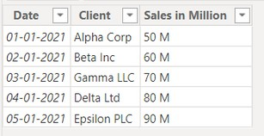
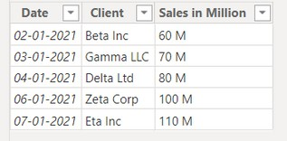
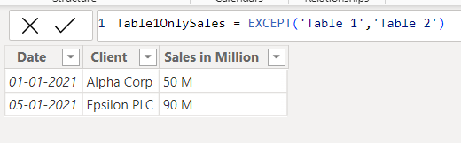

EXCEPT
The EXCEPT function returns a table (result set) that contains all the rows from the first table except for the rows that are also present in the second table. Essentially, it performs a set difference operation
Let’s see
with example
next
Syntax
Example
EXCEPT(<table_expression1>, <table_expression2>)
Here just i’m taking for example to understand.
Lets take two tables, Table1 and Table2, representing sales data for different clients on different dates. The tables contain the following columns:
Table 1 Table 2
How can you create a table that includes all the rows from Table1 that are not present in Table2?
The EXCEPT function returns the rows
from Table1 that do not exist in Table2.

Slide 4

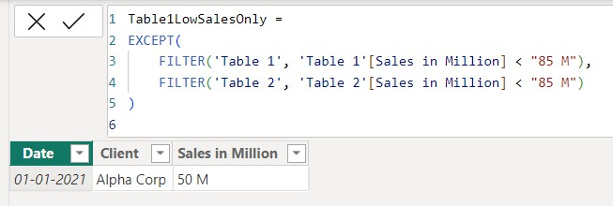

Next Example using filters
Example
Here just i’m taking for example to understand.
How can you create a table that includes all the rows from Table1 that are not
present in Table2 where the Sales in Million is less than 85 M? _{Understood?}
Table 1
Table 2
The EXCEPT function with filters returns the rows from Table1 that do not exist in Table2 where the sales amount is less than 85 million.

Slide 5
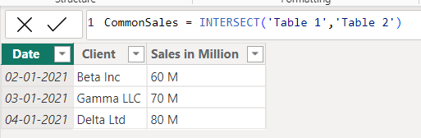
INTERSECT
The INTERSECT function returns a table that contains rows found in both the first and second tables. Essentially, it performs a set intersection operation.
Let’s see
Syntax
Example
INTERSECT(<table_expression1>, <table_expression2>)
with exampl
next
Here just i’m taking for example to understand.
Lets take two tables, Table1 and Table2, representing sales data for different clients on different dates. The tables contain the following columns:
Table 1 Table 2
How can you create a table that includes all the rows present in both Table1 and Table2?
The INTERSECT function returns the common rows present in both Table1 and Table2

Slide 6
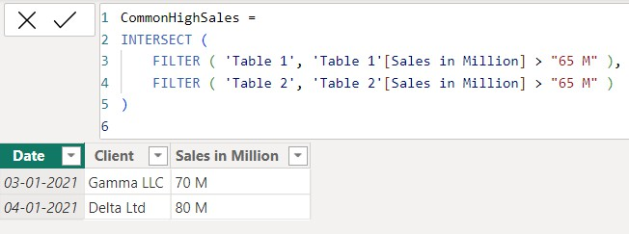
Next Example using filters
Example
Here just i’m taking for example to understand.
How can you create a table that includes all the rows present in both Table1
and Table2 where the Sales in Million is greater than 65 M? _{Understood?}
Table 1
Table 2
The INTERSECT function with filters returns the common rows present in both tables where the sales amount is greater than 65 million.

Slide 7


Thank you for joining me today to learn about Part -41 of Power BI!
Remember, Learning DAX is key to unlocking the full potential of Power BI for insightful reporting and visualization.
Stay tuned for more insights and tips on Power BI in our next Series.
Follow
Siddhika Shah

